Slide 1
Battleship AI
Finn Boyle, 18034590

Slide 2
Problem Definition and Motivation
What?
I am looking to improve upon previous computerised Battleship games by creating an AI that can improve its targeting after every game.
Why?
Creating a Battleship game is not something I have done before, and it seemed like it would be a good test of my skills.
Many of the Battleship AIs in my research work by determining targeting based on the current game only.
I think a constantly learning AI would provide a better opponent.

Slide 3
Methodology/Implementation
Game board and logic development
Feature testing (No AI)
Basic AI implementation
Shoot next to recorded hits, find patterns
Checkerboard pattern
Else, random firing
Basic AI testing

Slide 4
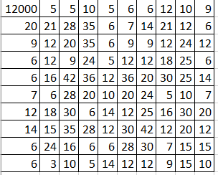
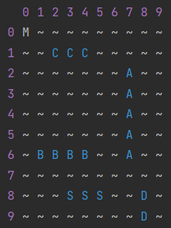
Methodology/Implementation, cont.
Advanced AI implementation
Updating and retrieving historical game data
Weighting historical game data
Certainty requirement catches outliers
Predicting where players will have placed their ships
Advanced AI testing
Artificially biased shot data

Slide 5
Evaluation
The overall game works!
My AI is an improvement on the basic AI
Makes use of:
supervised learning
Heuristic searching
Limited knowledge representation
However, my AI is susceptible to bias

Slide 6
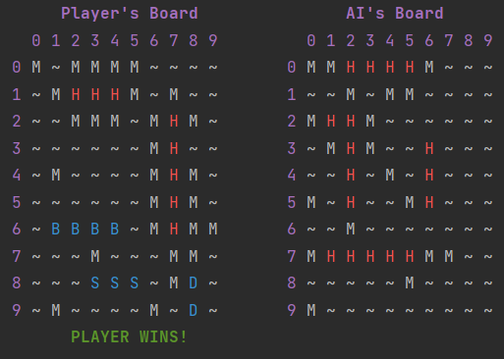
Discussion – Limitations/Future Work
Limitations
Order of implementation of features
I built an AI around a game, rather than building a game around an AI
Manual AI training
Future Work
Improving the AI targeting further
Currently surrounds a sunk ship in misses, looking for further hits
Changing strategies
In case the player can access the training dataset, AI needs to swap strategies to be able to beat the player
Allowing the AI to place its own ships
Currently randomised
AI has started surrounding player ships

Slide 7
Thank You!

